Slide 1

Digital Fundamentals
Tenth Edition
Floyd
Chapter 8
© 2008 Pearson Education

Slide 2
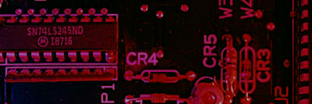
Summary
Counting in Binary
As you know, the binary count sequence follows a familiar pattern of 0’s and 1’s as described in Section 2-2 of the text.
0 0 0
0 0 1
0 1 0
0 1 1
1 0 0
1 0 1
1 1 0
1 1 1
LSB changes on every number.
The next bit changes on every other number.
The next bit changes on every fourth number.

Slide 3
Summary
Counting in Binary
A counter can form the same pattern of 0’s and 1’s with logic levels. The first stage in the counter represents the least significant bit – notice that these waveforms follow the same pattern as counting in binary.
LSB
MSB

Slide 4
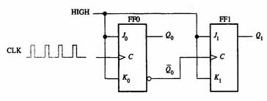
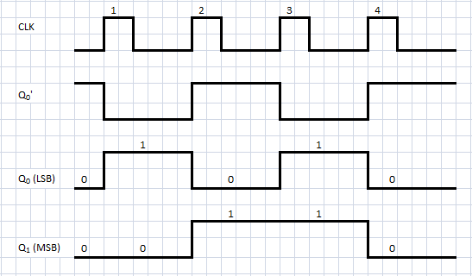
Summary
Two bit Asynchronous Counter
In a 2-bit asynchronous counter, the clock is applied only to the first stage. Second stage derive the clock from the previous stage.

Slide 5
Summary
Three bit Asynchronous Counter
In an asynchronous counter, the clock is applied only to the first stage. Subsequent stages derive the clock from the previous stage.
The three-bit asynchronous counter shown is typical. It uses J-K flip-flops in the toggle mode.
HIGH
J₀
Q₀
J₁
Q₁
J₂
Q₂
CLK
C
C
C
Q₀
Q₁
K₀
K₁
K₂
Waveforms are on the following slide…

Slide 6
Summary
Three bit Asynchronous Counter
Notice that the Q₀ output is triggered on the leading edge of the clock signal. The following stage is triggered from Q₀. The leading edge of Q₀ is equivalent to the trailing edge of Q₀. The resulting sequence is that of an 3-bit binary up counter.
CLK
Q₀
Q₁
Q₂

Slide 7
Summary
Propagation Delay
Asynchronous counters are sometimes called ripple counters, because the stages do not all change together. For certain applications requiring high clock rates, this is a major disadvantage.
Notice how delays are cumulative as each stage in a counter is clocked later than the previous stage.
CLK
Q₀
Q₁
Q₂
Q₀ is delayed by 1 propagation delay, Q₂ by 2 delays and Q₃ by 3 delays.

Slide 8
Summary
Truncated Counters
Counter Modulus: The number of unique states through which the counter will sequence.
Max possible states (Max Mod) = 2^{n} (where n is total FFs)
Truncated counters: Counters that count less than the maximum modulus (max states). Less than max states sequence is called truncated sequence.
MOD10 or Decade counters: Counters that count 10 distinct states.
Decade counter with sequence from 0000 to 1001 is a BCD decade counter.

Slide 9
Summary
Asynchronous Decade Counter
This counter uses partial decoding to recycle the count sequence to zero after the 1001 state. The flip-flops are trailing-edge triggered, so clocks are derived from the Q outputs. Other truncated sequences can be obtained using a similar technique.
CLR
HIGH
Q₀
Q₁
Q₂
Q₃
J₀
J₁
J₂
J₃
CLK
C
C
C
C
K₀
K₁
K₂
K₃
Waveforms are on the following slide…

Slide 10
Summary
Asynchronous Decade Counter
When Q₁ and Q₃ are HIGH together, the counter is cleared by a “glitch” on the CLR line.
CLK
Q₀
Q₁
Glitch
Q₂
Q₃
CLR
Glitch

Slide 11
Summary
Class Exercise - Asynchronous Truncated Counters
This counter uses partial decoding to recycle the count sequence to zero after the 1001 state. The flip-flops are trailing-edge triggered, so clocks are derived from the Q outputs. Other truncated sequences can be obtained using a similar technique.
CLR
HIGH
Q₀
Q₁
Q₂
Q₃
J₀
J₁
J₂
J₃
CLK
C
C
C
C
K₀
K₁
K₂
K₃

Slide 12
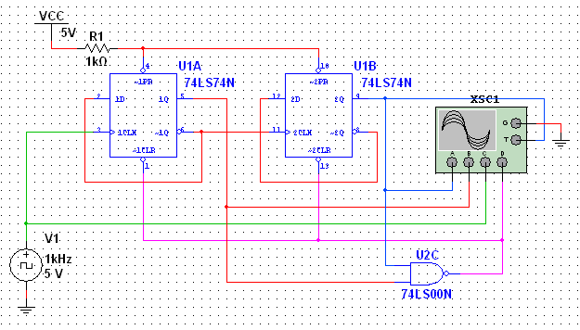
Summary
Asynchronous Counter Using D Flip-flops
D flip-flops can be set to toggle and used as asynchronous counters by connecting Q back to D. The counter in this slide is a Multisim simulation of one described in the lab manual. Can you figure out the sequence?
LSB
MSB
Q to D puts D flip-flop in toggle mode
The next slide shows the scope…

Slide 13
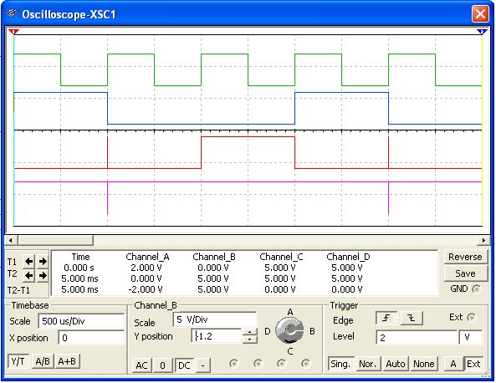
Summary
CLK
LSB
MSB
CLR
Note that it is momentarily in state 3 which causes it to clear.
The sequence is 0 – 2 – 1 – (CLR) (repeat)…

Slide 14
Summary
The 74LS93A Asynchronous Counter
The 74LS93A has one independent toggle J-K flip-flop driven by CLK A and three toggle J-K flip-flops that form an asynchronous counter driven by CLK B.
The counter can be extended to form a 4-bit counter by connecting Q₀ to the CLK B input. Two inputs are provided that clear the count.
CLK B
J₀
J₁
J₂
J₃
CLK A
C
C
C
C
K₀
K₁
K₂
K₃
All J and K inputs are connected internally HIGH
RO (1)
RO (2)
Q₀
Q₁
Q₂
Q₃

Slide 15
Summary
Synchronous Counters
In a synchronous counter all flip-flops are clocked together with a common clock pulse.
The most important advantage of synchronous counters is that there is no cumulative time delay because all flip-flops are triggered in parallel. Thus, the maximum operating frequency for this counter will be significantly higher than for the corresponding ripple counter.
Synchronous counters generally require more circuitry to control states changes.

Slide 16
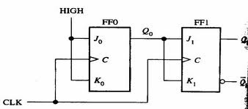
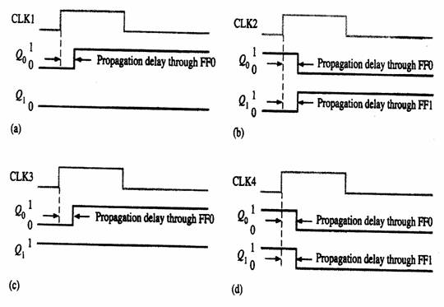
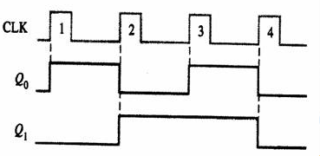
Summary
2-bit Synchronous Counter
Q1
Q1

Slide 17
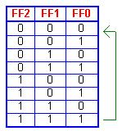
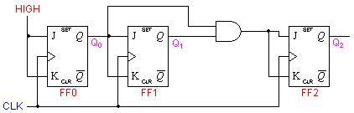
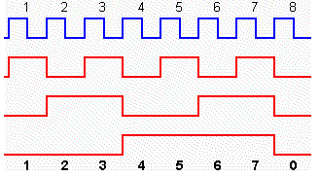
Summary
3-bit Synchronous Counter
1 2 3 4 5 6 7 8
FF0
FF1
FF2
0
0
0
1
0
0
0
1
0
1
1
0
0
0
1
1
0
1
0
1
1
1
1
0
0
0
0

Slide 18
Summary
3-bit Synchronous Counter
This 3-bit binary synchronous counter has the same count sequence as the 3-bit asynchronous counter shown previously
HIGH
Q₀
Q₀
Q₁
Q₀Q₁
J₀
J₁
J₂
Q₂
C
C
C
K₀
K₁
K₂
CLK

Slide 19
Summary
Analysis of Synchronous Counters
A tabular technique for analysis is illustrated for the counter on the previous slide. Start by setting up the outputs as shown, then write the logic equation for each input. This has been done for the counter.
1. Put the counter in an arbitrary state; then determine the inputs for this state.
2. Use the new inputs to determine the next state: Q₂ and Q₁ will latch and Q₀ will toggle.
3. Set up the next group of inputs from the current output.
Outputs
Logic for inputs
Q₂ Q₁ Q₀ | J₂ = Q₀Q₁ | K₂ = Q₀Q₁ | J₁ = Q₀ | K₁ = Q₀ | J₀ = 1 | K₀ = 1
0 0 0
0
0
0
0
1
1
0 0 1
0
0
1
1
1
1
0 1 0
4. Q₂ will latch again but both Q₁ and Q₀ will toggle.
Continue like this, to complete the table. The next slide shows the completed table…

Slide 20
Summary
Analysis of Synchronous Counters
Outputs
Logic for inputs
Q₂ Q₁ Q₀ | J₂ = Q₀Q₁ | K₂ = Q₀Q₁ | J₁ = Q₀ | K₁ = Q₀ | J₀ = 1 | K₀ = 1
0 0 0
0
0
0
0
1
1
0 0 1
0
0
1
1
1
1
0 1 0
0
0
0
0
1
1
0 1 1
1
1
1
1
1
1
1 0 0
0
0
0
0
1
1
1 0 1
0
0
1
1
1
1
1 1 0
0
0
0
0
1
1
1 1 1
1
1
1
1
1
1
0 0 0
At this points all states have been accounted for and the counter is ready to recycle…

Slide 21
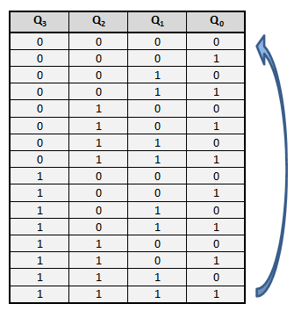
Summary
A 4-bit Synchronous Binary Counter
Q₁Q₀ = 11
Q₂Q₁Q₀ = 111

Slide 22
Summary
A 4-bit Synchronous Binary Counter
The 4-bit binary counter has one more AND gate than the 3-bit counter just described. The shaded areas show where the AND gate outputs are HIGH causing the next FF to toggle.
Q₀
Q₁
Q₂
Q₃

Slide 23
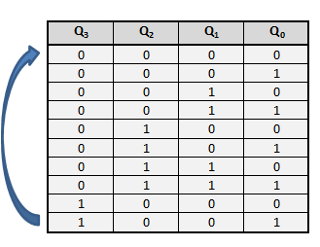
Summary
BCD Decade Counter
BCD synchronous decade counter counts from 0000 to 1001, then recycles to 0000.
Input conditions / logic equations at different counter stages:
?
J₀ = K₀ = 1
J₁ = K₁ = Q₀Q₃
J₂ = K₂ = Q₀Q₁
J₃ = K₃ = Q₀Q₁Q₂ + Q₀Q₃
?
?
?

Slide 24
Summary
BCD Decade Counter
With some additional logic, a binary counter can be converted to a BCD synchronous decade counter. After reaching the count 1001, the counter recycles to 0000.
This gate detects 1001, and causes FF3 to toggle on the next clock pulse. FF0 toggles on every clock pulse. Thus, the count starts over at 0000.
Q₃
Q₀

Slide 25
Summary
BCD Decade Counter
Waveforms for the decade counter:
CLK
Q₀
Q₁
Q₂
Q₃
These same waveforms can be obtained with an asynchronous counter in IC form – the 74LS90. It is available in a dual version – the 74LS390, which can be cascaded. It is slower than synchronous counters (max count frequency is 35 MHz), but is simpler.

Slide 26
Summary
A 4-bit Synchronous Binary Counter
The 74LS163 is a 4-bit IC synchronous counter with additional features over a basic counter. It has parallel load, a CLR input, two chip enables, and a ripple count output that signals when the count has reached the terminal count.
Data inputs
D₀
D₁
D₂
D₃
CLR
LOAD
ENT
RCO
ENP
CLK
Example waveforms are on the next slide…
Q₀
Q₁
Q₂
Q₃
Data outputs

Slide 27
Summary
CLR
LOAD
D₀
Data inputs
D₁
D₂
D₃
CLK
ENP
ENT
Q₀
Data outputs
Q₁
Q₂
Q₃
RCO
12 13 14 15 0 1 2
Count Inhibit
Clear Preset

Slide 28
Summary
Up/Down Synchronous Counters
An up/down counter is capable of progressing in either direction depending on a control input.
UP
Q₀.UP
HIGH
FF0
FF1
FF2
Q₂
J₀
Q₀
J₁
Q₁
J₂
UP/DOWN
C
C
C
Q₀
Q₁
Q₂
K₀
K₁
K₂
DOWN
Q₀.DOWN
CLK

Slide 29
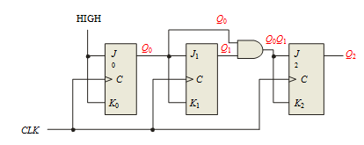
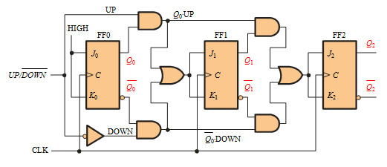
Summary
Compare Up/Down Counters with Simple Up counter
Implement Up logic as shown
Duplicate the Down Logic on
same grounds

Slide 30
Summary
Up/Down Synchronous Counter Analysis
Clock Pulse | UP | Q2 | Q1 | Q0 | DOWN
0 | ↘ | 0 | 0 | 0 | ↖
1 | ↘ | 0 | 0 | 1 | ↖
2 | ↘ | 0 | 1 | 0 | ↖
3 | ↘ | 0 | 1 | 1 | ↖
4 | ↘ | 1 | 0 | 0 | ↖
5 | ↘ | 1 | 0 | 1 | ↖
6 | ↘ | 1 | 1 | 0 | ↖
7 | ↘ | 1 | 1 | 1 | ↖
The J and K inputs of different FFs must equal 1 (HIGH) under the conditions expressed by the following equations to make them toggle:
J₀ = K₀ = 1
J₁ = K₁ = (Q₀ • UP) + (Q₀ • DOWN)
J₂ = K₂ = (Q₀ • Q₁ • UP) + (Q₀ • Q₁ • DOWN)

Slide 31
Summary
Up/Down Synchronous Counters
J₀ = K₀ = 1
J₁ = K₁ = (Q₀ • UP) + (Q₀ • DOWN)
J₂ = K₂ = (Q₀ • Q₁ • UP) + (Q₀ • Q₁ • DOWN)
UP
Q₀.UP
HIGH
FF0
FF1
FF2
Q₂
J₀
Q₀
J₁
Q₁
J₂
UP/DOWN
C
C
C
Q₀
Q₁
Q₂
K₀
K₁
K₂
DOWN
Q₀.DOWN
CLK

Slide 32
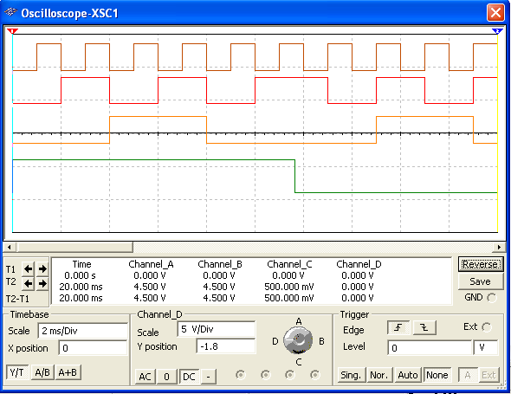
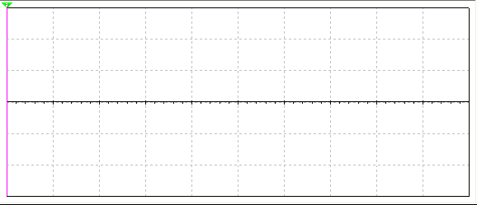
Summary
Up/Down Synchronous Counters
Q₀
Q₁
Q₂
UP/DOWN
Count up
Count down

Slide 33
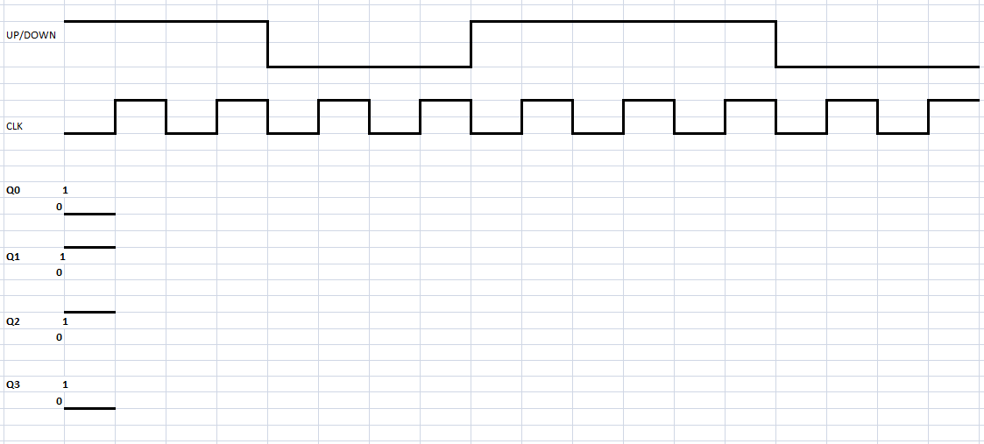
˄
˄
˄
Summary
Up/Down Synchronous Counters
Plot counter output
˄
˄
˄
˄
˄
˄
˄
˄
˄
1
0
1
0
1
0
1
0

Slide 34
Summary
Up/Down Synchronous Counters
D₀
D₁
D₂
D₃
Data inputs
The 74HC190 is a high speed CMOS synchronous up/down decade counter with parallel load capability. It also has a active LOW ripple clock output (RCO) and a MAX/MIN output when the terminal count is reached.
74HC190
CTEN
MAX/MIN
D/U
CTR DIV 10
LOAD
CLK
C
RCO
Q₀
Q₁
Q₂
Q₃
Data outputs
D₀
D₁
D₂
D₃
Data inputs
The 74HC191 has the same inputs and outputs but is a synchronous up/down binary counter.
74HC191
CTEN
MAX/MIN
D/U
CTR DIV 16
LOAD
CLK
C
RCO
Q₀
Q₁
Q₂
Q₃
Data outputs

Slide 35
Summary
Gray Code Counter Design
Required Flip-flops → 3. No undesired states.
State diagram:
Next state table:

Slide 36
Summary
Towards Gray Code Excitation Table
Transition Table

Slide 37
Summary
Gray Code Excitation Table
Q₂ | Q₁ | Q₀ | J₀ | K₀ | J₁ | K₁ | J₂ | K₂
0 | 0 | 0 | 1 | X | 0 | X | 0 | X
0 | 0 | 1 | X | 0 | 1 | X | 0 | X
0 | 1 | 1 | X | 1 | X | 0 | 0 | X
0 | 1 | 0 | 0 | X | X | 0 | 1 | X
1 | 1 | 0 | 1 | X | X | 0 | X | 0
1 | 1 | 1 | X | 0 | X | 1 | X | 0
1 | 0 | 1 | X | 1 | 0 | X | X | 0
1 | 0 | 0 | 0 | X | 0 | X | X | 1

Slide 38
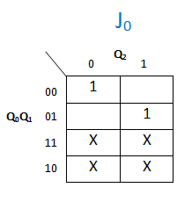
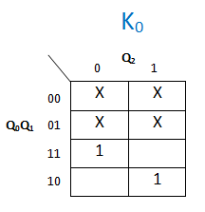
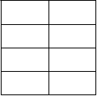
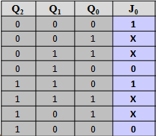

Summary
Gray Code Counter Design
Use K-Map to determine equations for J₀, K₀, J₁, K₁, J₂ and K₂
Q₁Q₂ + Q₁Q₂
Q₁Q₂ + Q₁Q₂

Slide 39
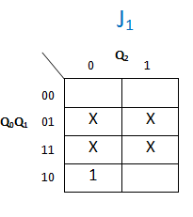
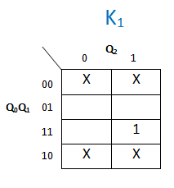
Summary
Gray Code Counter Design
Use K-Map to determine equations for J₀, K₀, J₁, K₁, J₂ and K₂
Q₀Q₂
Q₀Q₂

Slide 40
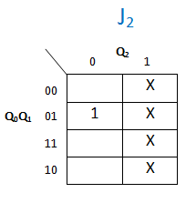
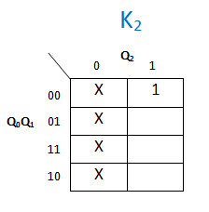
Summary
Gray Code Counter Design
Use K-Map to determine equations for J₀, K₀, J₁, K₁, J₂ and K₂
Q₀Q₁
Q₀Q₁

Slide 41
Summary
Gray Code Counter Design
Equations for J₀, K₀, J₁, K₁, J₂ and K₂
J₀ = Q₁Q₂ + Q₁Q₂
K₀ = Q₁Q₂ + Q₁Q₂
J₁ = Q₀Q₂
K₁ = Q₀Q₂
J₂ = Q₀Q₁
K₂ = Q₀Q₁

Slide 42
Summary
Gray Code Counter
FF0
FF1
FF2
Q₂
J₀
Q₀
J₁
Q₁
J₂
C
C
C
Q₀
Q₁
Q₂
K₀
K₁
K₂
CLK
The circuit can be checked with Cedarlogic before constructing it.

Slide 43
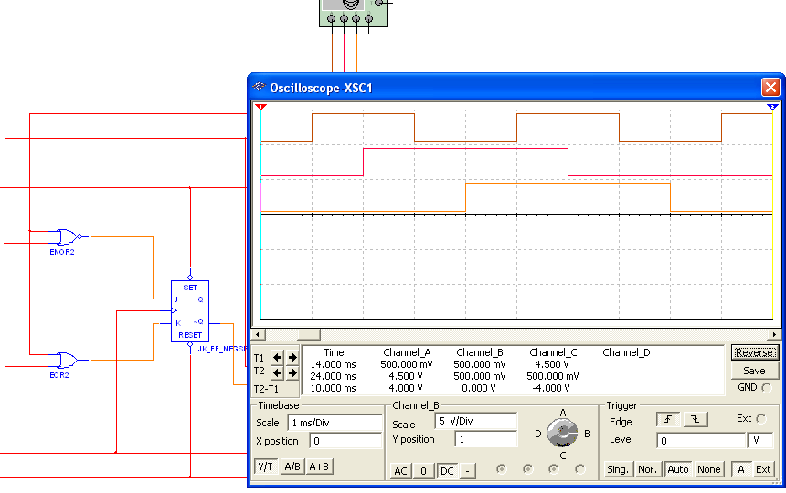

Summary
Gray Code Counter
Q₀
Q₁
Q₂

Slide 44
Summary
Counters with Arbitrary Sequences
Design a MOD-6 synchronous counter which follow the count sequence 000 , 010 , 011 , 001 , 100 , 110 , 000 , 010 …….
Step -1
Determine the number of flip-flops required for the purpose. Identify the undesired states. In the present case, the number of flip-flops required is 3 and the undesired states are 101 and 111

Slide 45
Summary
Counters with Arbitrary Sequences
Step - 2
Draw the state transition diagram showing all possible states including the ones that are not desired. The undesired states should be depicted to be transiting to any of the desired states. We have chosen the 000 state for this purpose. It is important to include the undesired states to ensure that, if the counter accidentally gets into any of these undesired states, it will go to a desired state to resume the correct sequence on application of the next clock pulse.

Slide 46
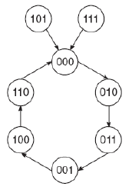
Summary
Counters with Arbitrary Sequences
Step – 2 State Transition Diagram

Slide 47
Summary
Counters with Arbitrary Sequences
Step – 3
Draw the excitation table for the counter, listing the present states, the next states corresponding to the present states and the required logic status of the flip-flop inputs (the J and K inputs).

Slide 48
Summary
Counters with Arbitrary Sequences
J-K transition table
JK Truth Table

Slide 49
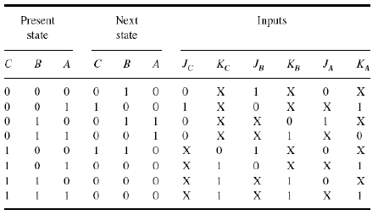
Summary
Counters with Arbitrary Sequences
Step – 3 Excitation Table

Slide 50
Summary
Counters with Arbitrary Sequences
Step – 4
Generate J_{A}, K_{A}, J_{B}, K_{B}, J_{C} and K_{C} inputs from available A, A’, B, B’, C and C’ outputs of FFs.
This is done by drawing Karnaugh maps for each one of the inputs, minimizing them and writing Boolean equations.

Slide 51
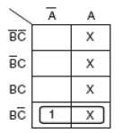

Summary
Counters with Arbitrary Sequences
Step – 4 Karnaugh Mapping - J_{A}

Slide 52
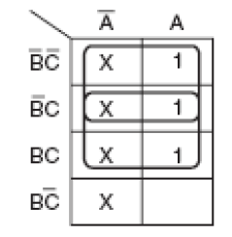

Summary
Counters with Arbitrary Sequences
Step – 4 Karnaugh Mapping - K_{A}

Slide 53
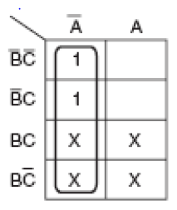

Summary
Counters with Arbitrary Sequences
Step – 4 Karnaugh Mapping - J_{B}

Slide 54
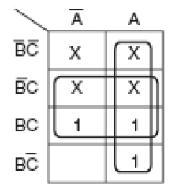

Summary
Counters with Arbitrary Sequences
Step – 4 Karnaugh Mapping - K_{B}

Slide 55
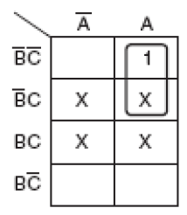

Summary
Counters with Arbitrary Sequences
Step – 4 Karnaugh Mapping - J_{C}

Slide 56
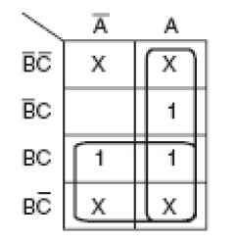

Summary
Counters with Arbitrary Sequences
Step – 4 Karnaugh Mapping - K_{C}

Slide 57
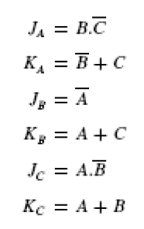
Summary
Counters with Arbitrary Sequences
Step – 5
When all input conditions are obtained, a circuit can be drawn that will produce the desired output. The circuit can be tested in software before implementation.

Slide 58
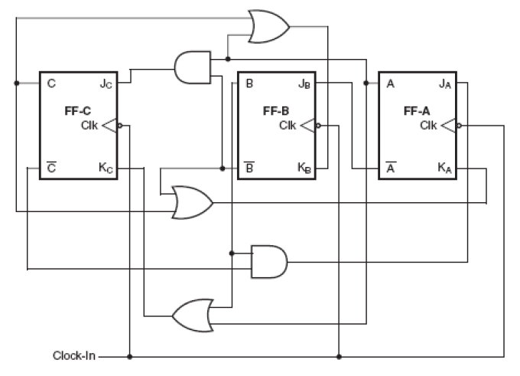
Summary
Counters with Arbitrary Sequences
Step – 5

Slide 59
Summary
Cascaded counters
Cascading is a method of achieving higher-modulus counters. For synchronous IC counters, the next counter is enabled only when the terminal count of the previous stage is reached.
HIGH
Counter 1
Counter 2
f_{out}
CTEN
TC
CTEN
TC
CTR DIV 16
CTR DIV 16
CLK
C
Q₀
Q₂
Q₁
Q₃
C
Q₀
Q₂
Q₁
Q₃
f_{in}
Example
What is the modulus of the cascaded DIV 16 counters?
If f_{in} =100 kHz, what is f_{out}?
Solution
a) Each counter divides the frequency by 16. Thus the modulus is 16² = 256.
b) The output frequency is 100 kHz/256 = 391 Hz

Slide 60
Summary
Counter Decoding
Decoding is the detection of a binary number and can be done with an AND gate.
Question
What number is decoded by this gate?

Slide 61
Summary
Partial Decoding
The decade counter shown previously incorporates partial decoding (looking at only the MSB and the LSB) to detect 1001. This was possible because this is the first occurrence of this combination in the sequence.
Detects 1001 by looking only at two bits

Slide 62
Summary
Resetting the Count with a Decoder
The divide-by-60 counter in the text also uses partial decoding to clear the tens count when a 6 was detected.
The divide characteristic illustrated here is a good way to obtain a lower frequency using a counter. For example, the 60 Hz power line can be converted to 1 Hz.

Slide 63
Summary
Counter Decoding
Example
Show how to decode state 5 with an active LOW output.
Solution
Notice that a NAND gate was used to give the active LOW output.

Slide 64
Summary
Logic Symbols
Dependency notation allows the logical operation of a device to be determined from its logic symbol.
CTR DIV 16
Common control block
CLR
5CT = 0
D₀
D₁
D₂
D₃
LOAD
M1
M2
RCO
ENT
G3
CLR
ENP
G4
LOAD
CLK
C5/2,3,4
ENT
CTR DIV 16
RCO
ENP
D₀
Q₀
CLK
C
D₁
Q₁
D₂
Q₂
D₃
Q₃
Q₀
Q₁
Q₂
Q₃

Slide 65
Selected Key Terms
Asynchronous
Modulus
Synchronous
Terminal count
State machine
Cascade
Not occurring at the same time.
The number of unique states through which a counter will sequence.
Occurring at the same time.
The final state in a counter’s sequence.
A logic system exhibiting a sequence of states or values.
To connect “end-to-end” as when several counters are connected from the terminal count output of one to the enable input of the next counter.

Slide 66

Quiz
1. The counter shown below is an example of
a. an asynchronous counter
b. a BCD counter
c. a synchronous counter
d. none of the above
HIGH
J₀
Q₀
J₁
Q₁
J₂
Q₂
CLK
C
C
C
Q₀
Q₁
K₀
K₁
K₂
© 2008 Pearson Education

Slide 67
Quiz
The Q₀ output of the counter shown
a. is present before Q₁ or Q₂
b. changes on every clock pulse
c. has a higher frequency than Q₁ or Q₂
d. all of the above
HIGH
J₀
Q₀
J₁
Q₁
J₂
Q₂
CLK
C
C
C
Q₀
Q₁
K₀
K₁
K₂
© 2008 Pearson Education

Slide 68
Quiz
3. To cause a D flip-flop to toggle, connect the
a. clock to the D input
b. Q output to the D input
c. Q output to the D input
d. clock to the preset input
© 2008 Pearson Education

Slide 69
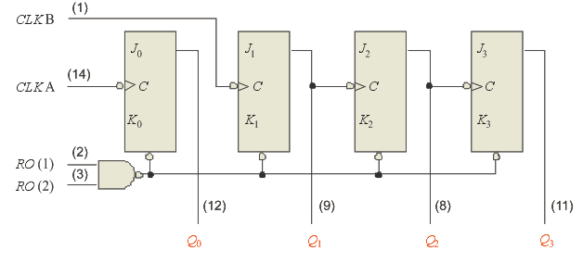
Quiz
4. The 7493A asynchronous counter diagram is shown (J’s and K’s are HIGH.) To make the count have a modulus of 16, connect
a. Q₀ to RO(1) and RO(2) to
b. Q₃ to RO(1) and RO(2)
c. CLK A and CLK B together
d. Q₀ to CLK B
© 2008 Pearson Education

Slide 70
Quiz
5. Assume Q₀ is LOW. The next clock pulse will cause
a. FF1 and FF2 to both toggle
b. FF1 and FF2 to both latch
c. FF1 to latch; FF2 to toggle
d. FF1 to toggle; FF2 to latch
FF0
FF1
FF2
LOW
© 2008 Pearson Education

Slide 71
Quiz
6. A 4-bit binary counter has a terminal count of
a. 4
b. 10
c. 15
d. 16
© 2008 Pearson Education

Slide 72
Quiz
7. Assume the clock for a 4-bit binary counter is 80 kHz. The output frequency of the fourth stage (Q₃) is
a. 5 kHz
b. 10 kHz
c. 20 kHz
d. 320 kHz
© 2008 Pearson Education

Slide 73
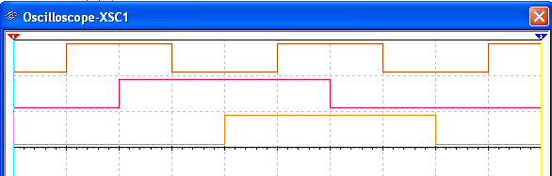
Quiz
8. A 3-bit count sequence is shown for a counter (Q₂ is the MSB). The sequence is
a. 0-1-2-3-4-5-6-7-0 (repeat)
b. 0-1-3-2-6-7-5-4-0 (repeat)
c. 0-2-4-6-1-3-5-7-0 (repeat)
d. 0-4-6-2-3-7-5-1-0 (repeat)
Q₀
Q₁
Q₂
© 2008 Pearson Education

Slide 74
Quiz
9. FF2 represents the MSB. The counts that are being decoded by the 3-input AND gates are
a. 2 and 3
b. 3 and 6
c. 2 and 5
d. 5 and 6
© 2008 Pearson Education

Slide 75
Quiz
10. Assume the input frequency (f_{in}) is 256 Hz. The output frequency (f_{out}) will be
a. 16 Hz
b. 1 kHz
c. 65 kHz
d. none of the above
HIGH
Counter 1
Counter 2
f_{out}
CTEN
TC
CTEN
TC
CTR DIV 16
CTR DIV 16
CLK
C
Q₀
Q₂
Q₁
Q₃
C
Q₀
Q₂
Q₁
Q₃
f_{in}
© 2008 Pearson Education

Slide 76
Quiz
Answers:
1. a
2. d
3. c
4. d
5. b
6. c
7. a
8. b
9. b
10. d

